Slide 1
America Needs a Uniform Data Breach, Security and Privacy Law That Preempts the States
2019 International Information Sharing Conference
August 21, 2019
Stuart M. Gerson
Epstein Becker & Green, P.C.
National Council of Registered ISAOs

Slide 2
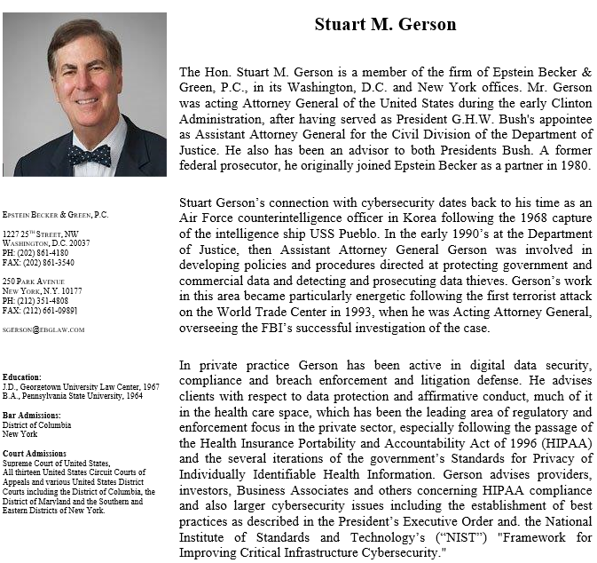

Slide 3
Regulatory Background and the Need for Change
Significant data breaches at every level of national life have pushed the privacy and security of personally-identifiable information (PII) to the forefront of state and federal policymakers’ agendas.
Preemption has been a consistent theme from American business.
Lately, security issues have risen in importance.
Public/private cooperation must be incented and improved.

Slide 4
A Confused and Misdirected Cybersecurity and Privacy Landscape
The United States currently has no national, unifying data-security or privacy law. There are industry-specific federal laws like The Health Insurance Portability and Accountability Act of 1996 (HIPAA; Pub.L. 104-191, 110 Stat. 1936, enacted August 21, 1996), but no specific law that crosses industries (the FTC Act notwithstanding).
A host of federal agencies are regulating at the margins and beyond, particularly the FTC, but also the SEC, FCC and DHHS OCR.

Slide 5
Every State and U.S. Territory Has Breach Notification Law of its Own, and an Increasing Number Have Data Privacy Laws. They Present a Hodgepodge of Contradictions.
• Differing and confusing definitions of covered entities;
• Varying requirements for third parties that maintain PII;
• Disparate definitions of what constitutes a reportable breach;
• Widely varying procedures regarding notices and timing in the case of a breach;

Slide 6
Every State and U.S. Territory Has Breach Notification Law of its Own, and an Increasing Number Have Data Privacies Laws. They Present a Hodgepodge of Contradictions.
• Inconsistent availability and extent of exemptions and safe harbors, e.g., for encryption, good-faith receipt of protected information, credit for compliance;
• Varying methods of enforcement, e.g., attorneys general, regulatory bodies, private rights of action;
• Irrationally differing penalties and required remedies;
• Uncertain rights and remedies for injured persons and litigants.

Slide 7
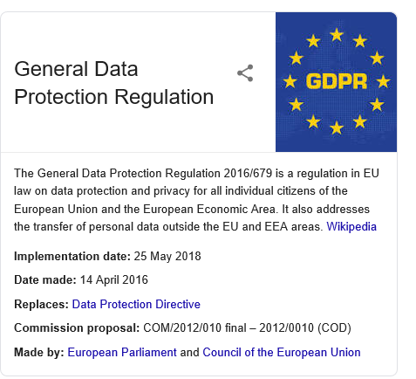
GDPR Has Become the Prototype

Slide 8
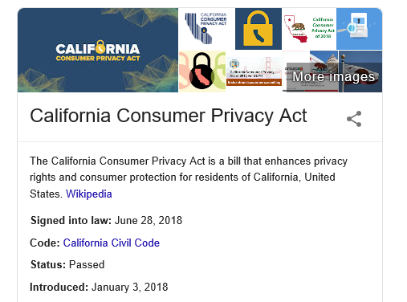
California First to Follow GDPR And Leader Among States.

Slide 9
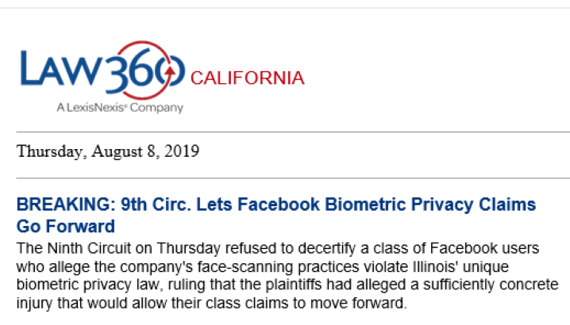
Illinois Sees a Different Burr Under The Saddle.

Slide 11
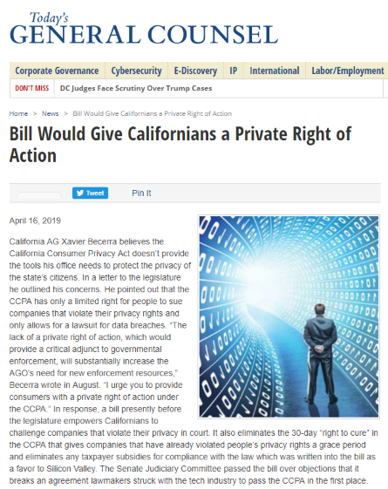
When GDPR Just Isn’t Enough

Slide 12
A California-like National Enforcement Regime Would Cost the Economy $122 Billion/Year
A targeted set of cost-effective privacy regulations could, according to the Information Technology and Innovation Foundation, reduce this expenditure by 95% to $6.5 billion/year.
And it could avoid GDPR shortcomings like too-easy access to the identity of others, collision with A/I and banning of resources like WHOIS.

Slide 13
The Status Quo Is Not Working Well Enough.
Despite a commitment to cyber compliance by data holders of all sizes, and their determined education of individuals about password protection, security of mobile devices, phishing, and other social engineering, reportable cyber incidents have grown by more than 1,500% since 2006
With massive ransomware attacks, zero-day exploits, and nation-state-sponsored onslaughts, the number of incidents, although somewhat down has become more problematic, despite a massive fine driven enforcement regime.

Slide 14
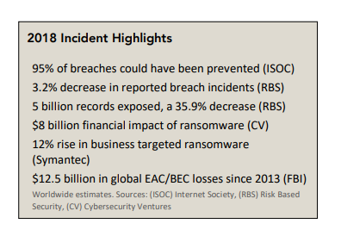
Last Year’s Incident Data Shows Vulnerabilities Still Proliferate Despite Apparent (And Misleading) Reduction. iferateD

Slide 15
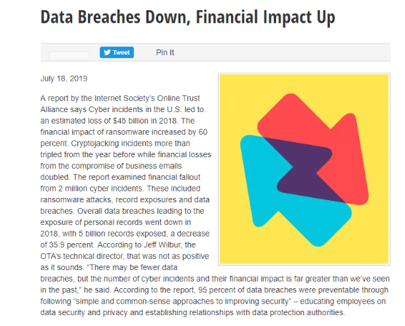
Breaches Down, But Thieves Are Focusing on The Big Stuff. 2018 Losses $45 Billion And Ransomware Impact Up by 60%

Slide 16
“Black Hat” Survey Offers a Warning as to Prevention’s Limit
90% of security pros believe that no matter how careful people are, it’s likely that their data is available to criminals at this very moment.
Only 30% believe that, because of social networks, it will be possible for consumers to protect their privacy and identities in the future."

Slide 17
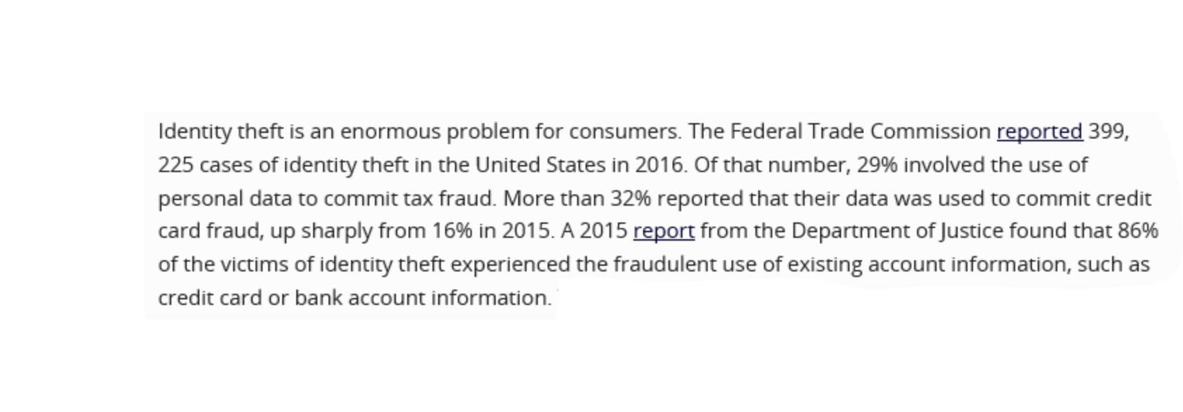
Identity Theft: But Who is the Victim?
Identity theft, while not a myth, is not the essential problem. Rarely are there plaintiffs with injury in fact in the multiplicity of class action law suits being filed. The U.S. is an ID theft victim as to tax refund requests, phony health care reimbursements, etc.

Slide 18
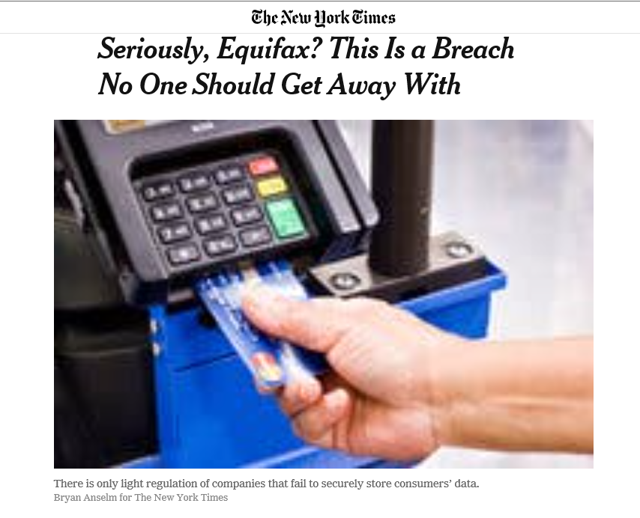
Poster Child Breaches are Misleading

Slide 19
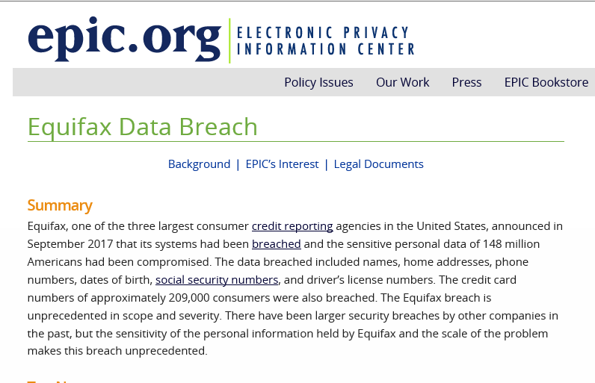
‘Sound Really Bad . . . .

Slide 20
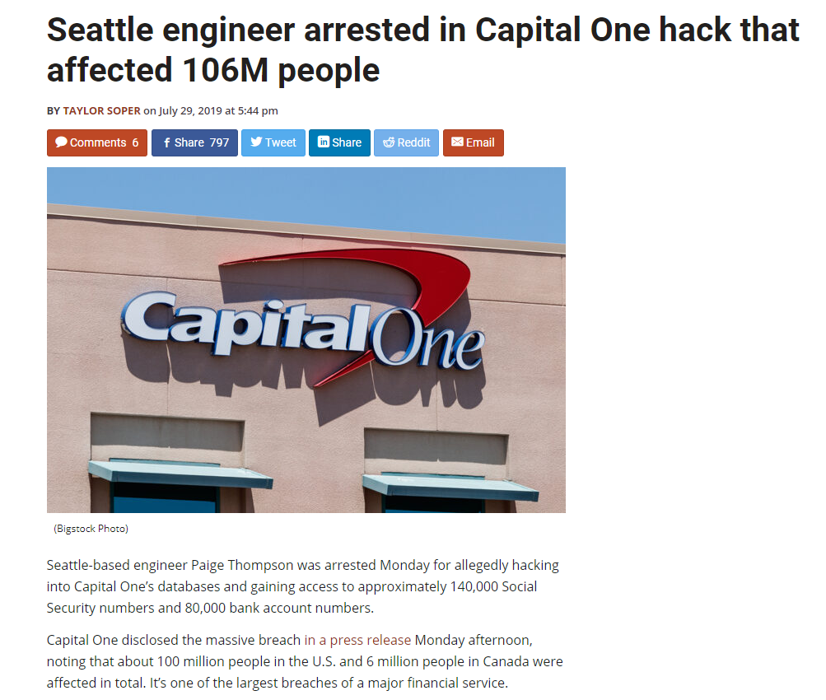
Capital One: I Thought the Cloud was Safe.

Slide 21
And the Settlement and Fines Seem Gigantic. But is That Really Fine?
Big GDPR fines have caused the U.S. to take notice. Europe is regulating an industry it doesn’t have. US could threaten the most dynamic industry it has created
Facebook’s $5-Billion Facebook’s FTC settlement includes the largest fine ever levied for data privacy violations
FTC announced Equifax will pay up to $700 million to consumers and the government under its settlement. And its data haven’t even been sold online.
FTC Chairman Joseph Simons said the case underscores the need for new civil-fines authority. Candidates like Senators Sanders and Warren would move to increase fines further, aping the 4% GDPR max per world revenues.

Slide 22
Cisco FCA Deal Shows Viability Of Cybersecurity Qui Tams
The July 31 $8.6 million False Claims Act settlement between Cisco Systems and the government — for Cisco's failure to adequately remedy a known cybersecurity vulnerability — will likely be the first of many such treble damage lawsuits given rewards available to whistleblowers under the FCA.
And the Supreme Court has yet to remedy the split among the courts of appeals as to standing of persons who fear injury but haven’t actually suffered any. More court’s allowing speculative, no-injury suits, e.g. 9th Circuit in Facebook biometric suit under Illinois law.

Slide 23
The Problem for the States Isn’t Just at the Voting Booth

Slide 24
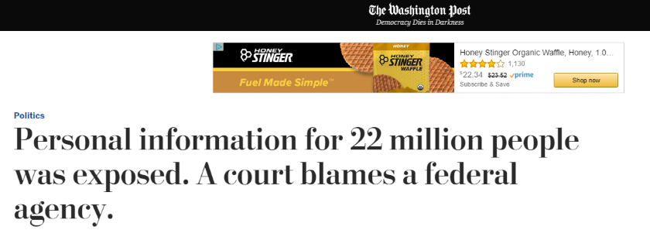
It Isn’t Just Companies; The Government Has The Very Same Problem. This One’s OPM, But Even The Regulatory Agencies Are Vulnerable.

Slide 25
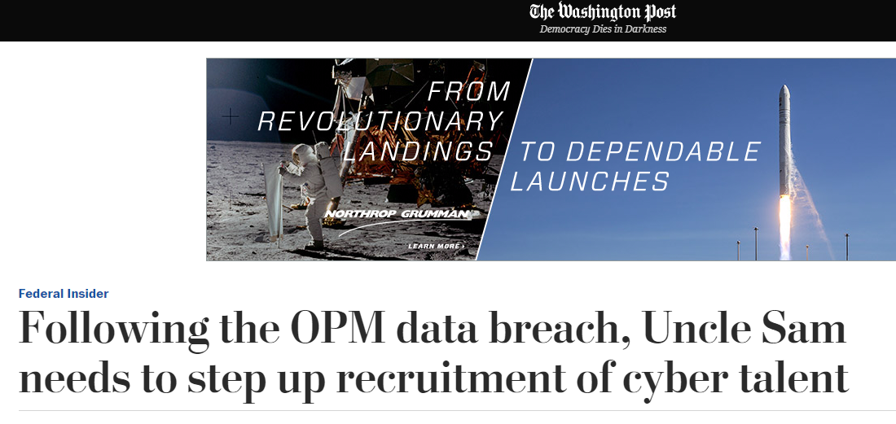
And They’re Less Well Equipped to Solve The Problem

Slide 26
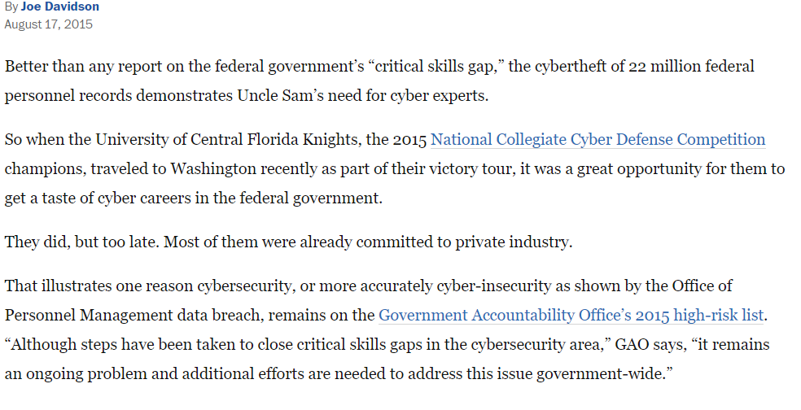
The Best White Hats Go For The Private $$

Slide 27
Fed Regulators Are No Better at Security Than The Companies They Regulate.
Eight federal agencies have systematically ignored warnings about security vulnerabilities that could lead to the type of Chinese-backed cyberattack of OPM that occurred in 2015 when according to the Senate Homeland Security and Governmental Affairs Subcommittee.
Several of these agencies that have supervisory responsibilities over private entities, e.g., SEC, DHHS, repeatedly have been criticized for unacceptable cyber compliance

Slide 28
We’re in at Least the Equivalent of Modern Warfare.

Slide 29
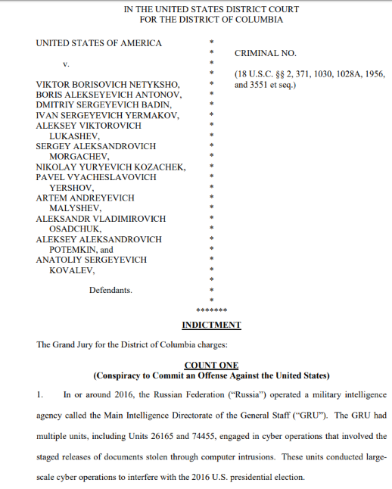
Russians Indicted

Slide 30
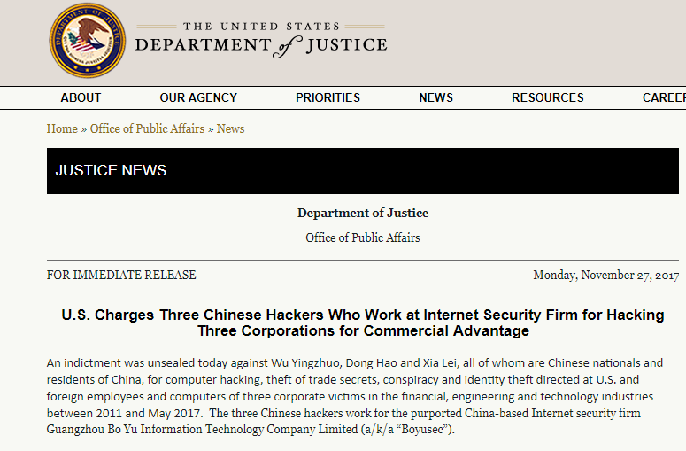
China

Slide 31
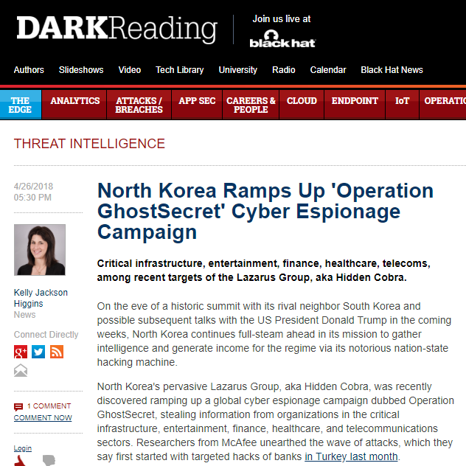
North Korea

Slide 32
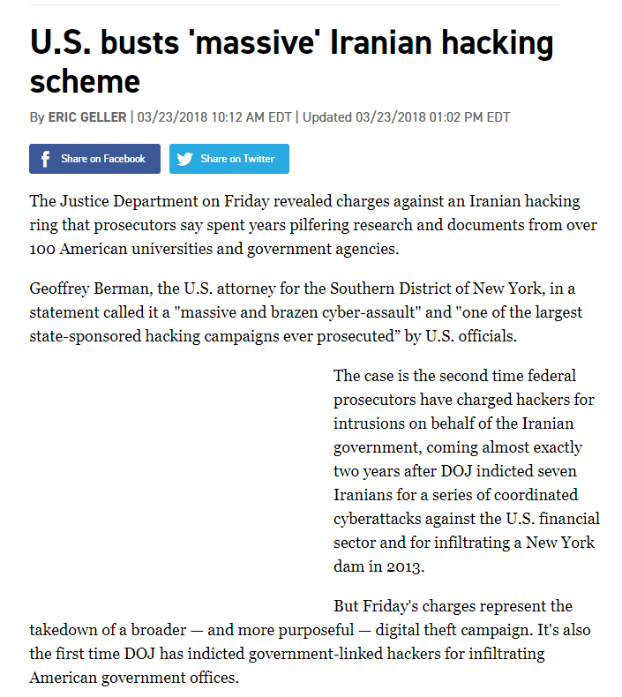
Iran

Slide 33
If the Mueller and Senate Reports Weren’t Enough
Cyber firm IntSights describes an advanced criminal hacking community in Russia and the Commonwealth of Independent States that operates with impunity -- as long as it's attacking abroad and steering clear of Russian government and industry targets.
Chinese law fosters the same thing. Have you seen the Chinese Space Shuttle?

Slide 34
What is the Likely Federal Regulatory Reality?

Slide 35
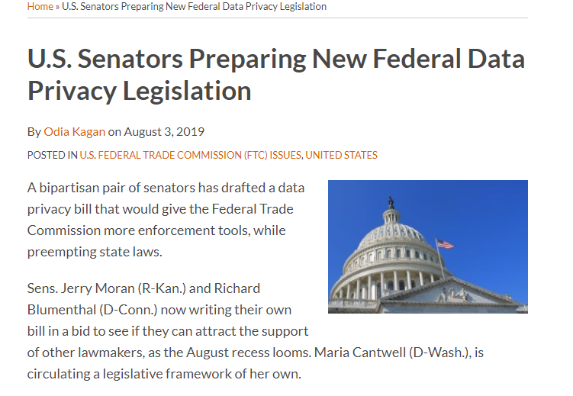
The FTC Will Be the Federal Enforcement Leader.

Slide 36
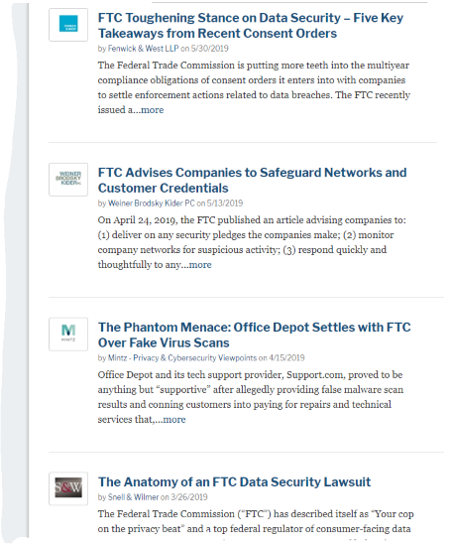
Jurisdiction Aside, The FTC is Forcing Big Buck $$ Settlements

Slide 37
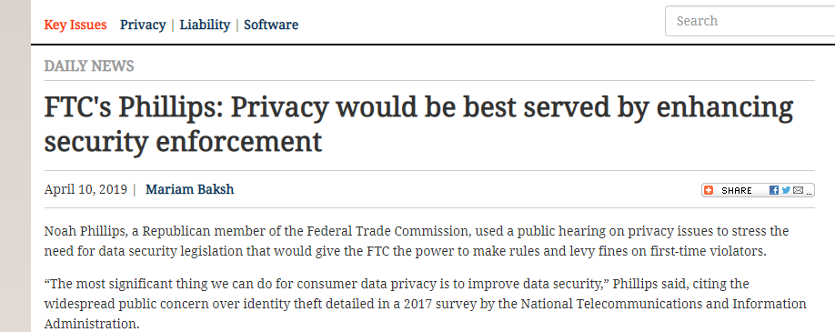
Privacy and Security: Separate or Equal.

Slide 38
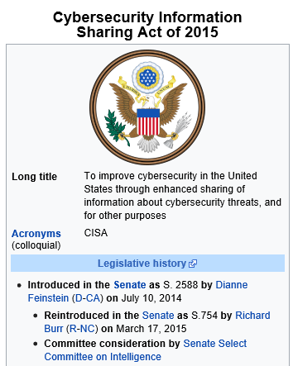
The Other “CISA.” The New One Ruins a Good Acronym.

Slide 39
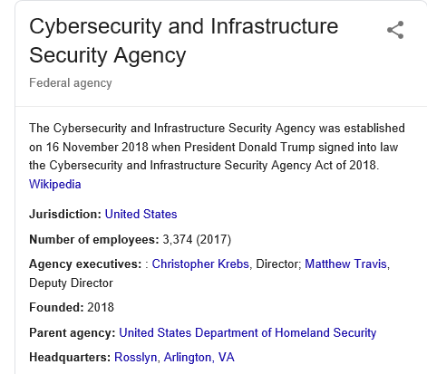
Can CISA And The FTC Productively Co-Exist?

Slide 40
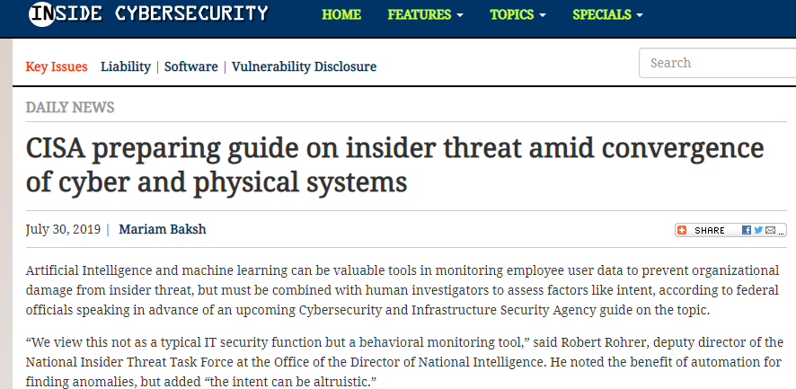
But CISA is Looking for Cooperation. Why Expect it?

Slide 41
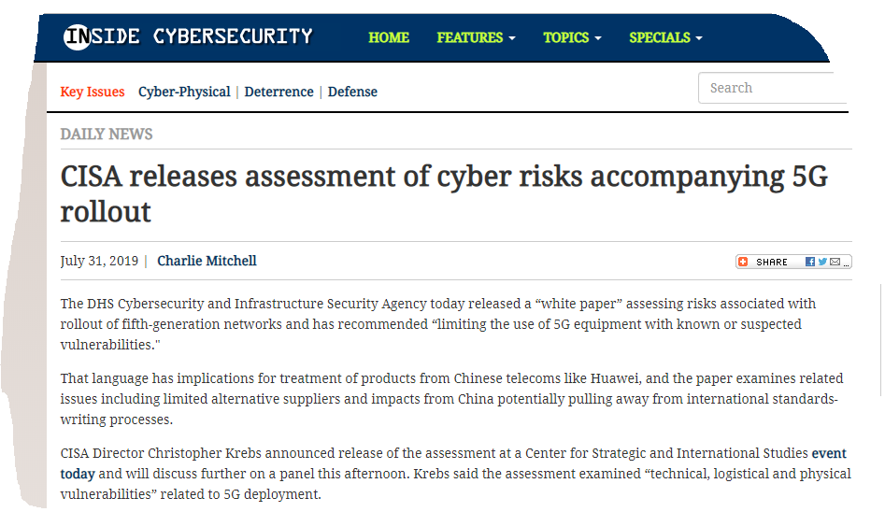
And Huawei, Too!

Slide 42
How to Win a War

Slide 43
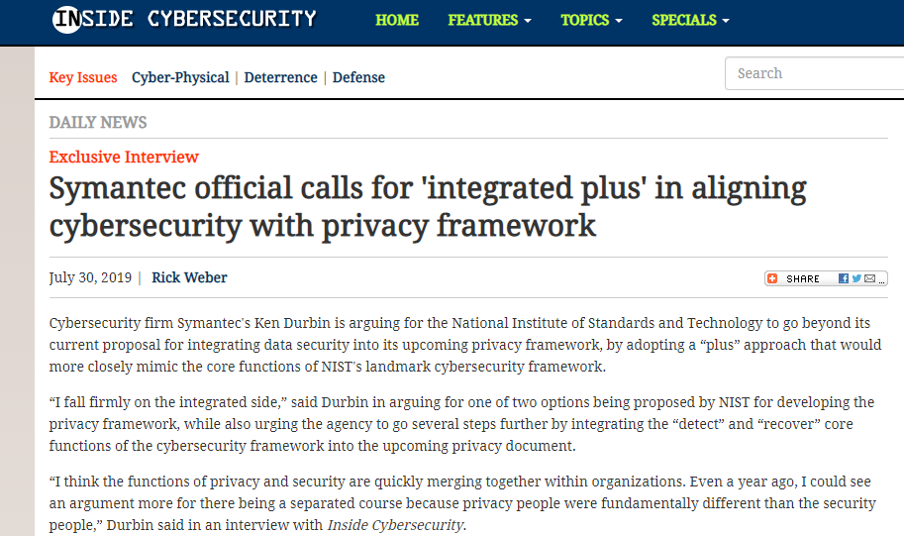
NIST Could be The Glue That Binds Public And Private Goals.

Slide 44
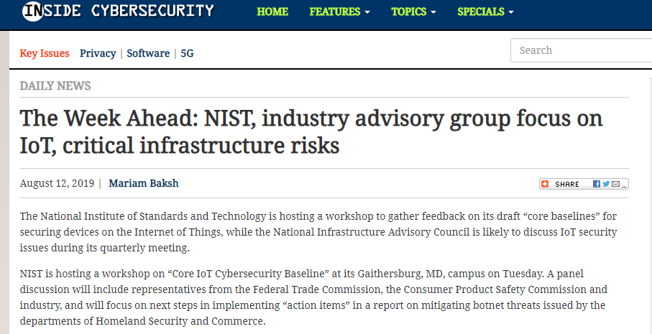
Securing All Aspects of The Critical Infrastructure.

Slide 45
What Should A New Law Do? Clear The Fog of War!
Privacy and cybersecurity should be treated together in an integrated framework approach.
Privacy and security mandates should apply nationwide.
They should apply to all sectors, public and private alike.
The law should preempt the myriad of State laws as to breach notification

Slide 46
What Should a New Law Do?
Compliance should be adaptive to industry and sector demands and should allow for cost-effectiveness analysis.
In the private sector, at least, there should be a safe harbor that, at a minimum creates a presumption of compliance.
Public/private partnership should be encouraged beyond just the critical infrastructure.
Private rights of action should be limited to cases of actual economic injury, not mere fear, and to gross negligence.

Slide 47
What Should a New Law Do?
• The NIST standard should be afforded primacy, but specialist agencies (e.g., SEC, DHHS Office of Civil Rights, FCC) may, by complying with the Administrative Procedure Act augment the federal regulatory regime.
• Recognizing what has become the status quo, the FTC should be acknowledged in the law to have enforcement primacy in consumer-related matters and its rulemaking and injunctive powers should be augmented.
• CISA must have primacy in dealing with technical means affecting the critical infrastructure, both physical and information systems.

Slide 48
A Cyber Reality Look Into The Future
Senate report on Russian hacking and election interference adds to news about adversaries’ ability to squat on the electrical grid and other vulnerabilities in the critical infrastructure, health care delivery systems and local government. Resilience is a big issue and government cannot solve the problem alone. Other recent evidence of Cloud and VPN vulnerabilities.
Problem of the future is data and public opinion manipulation by AI. Phishing and other social engineering will be increasingly automated and will create huge volume.
Companies could pool their threat data and have larger database than state sponsored hackers. Private interests can supplement government on vulnerabilities like “BlueKeep.” We don’t need more WannaCry or NotPetya.
And the “back door” demands of law enforcement will persist.

Slide 49
Our system of cyber-security and privacy management and defense should be national in scope. It should be consistent and it should be more cooperative than adversarial, though best practices should be defined and enforced sensibly (and compliance not only encouraged but rewarded. The public/private Manhattan Project “triad” must be restored.

